Slide 1


Data Mining 1 – Unsupervised Learning
Prof. Vandith Pamuru (vandith_pamuru@isb.edu)
Assistant Professor of Information Systems, ISB

Slide 2
Course Outline &
Evaluation Components
<< Course outline >>

Slide 3
A word on Honor Code
Individual Assignments (honor code 3N-b):
  No discussion with other students.
  Do not copy from or share with your classmates or even participants from previous batches.
  Copying solutions from external sources is not allowed. External references, e.g., books, journal articles, etc., can be used to develop better understanding only and should be cited whenever a direct reference is made. Citing external references ≠ copying content from external references.
Small group case assignments (honor code 3N-b)
    Same as above + absolutely no discussion with other groups
Group Projects (honor code 3N-b):
  Same as above + absolutely no discussion with other teams
Project evaluation in class (honor code 4N):
  Absolutely NO discussion with others, no external reference
Optional case assignments (honor code 0N)
  Can discuss with anyone, no submission is necessary
  It is not graded
Detection software is used for identifying overlaps with others’ works as well as external resources; in case a significant overlap is detected, the case is referred to the honor code committee.
Penalty for violating honor code = Getting zero + (reduce grade, fail, expel, ban from alumni privileges, ban from walking on the graduation ceremony, etc., based on the severity of the plagiarism)

Slide 4





Online Classroom Etiquettes

Slide 5
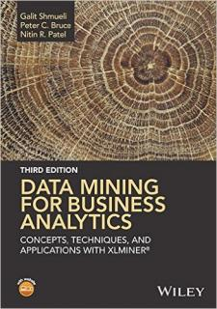


How the course is structured?
In-class
  Focus on understanding techniques and applications
  Using relatively small-scale dataset from the book’s website
  (www.dataminingbook.com)
  Some other small-scale publicly available data
  Datasets will be uploaded on the course website as well
Individual assignments
  Practice with relatively large datasets
  Dataset from the book’s website or cases
  Other publicly available real dataset
Tutorials
  Hands-on with real dataset
Small-group case assignments
  Example from the industry
  Real/orchestrated dataset
  Semi-open-ended
Group project
  Absolutely open-ended
  Real dataset will be provided

Slide 6
What is in the course?
How is this course different from Supervised Learning?

Slide 7
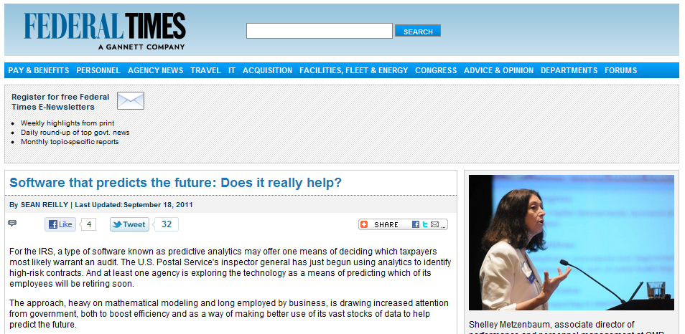

An example of Supervised Learning application
Decision vs. Prediction

Slide 8
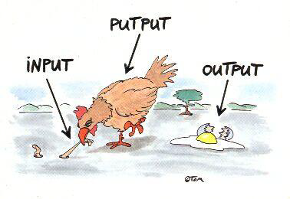
Types of Methods
Supervised Learning
(Predictive Analytics)
Unsupervised Learning
Prediction (numerical Y)
Classification (categorical Y)
Discover insightful structures in the data
Cluster Analysis
Dimension Reduction
Relationship Mining
Recommender System
Network Analysis
This course
Notes:
Unsupervised Learning: Discover a good internal representation of the input.

Slide 9
Discovering structure in the data
Deriving insights/ structure in the data
Visualization

Slide 10

We’ll also discuss a few applications on complementarities of supervised & unsupervised learning methods
Unsupervised Learning
Supervised Learning
Domain knowledge

Slide 11
What is OUTSIDE the scope of this class although relevant to what we do:
Scale―Big Data (e.g., analyzing unstructured data like text mining, dealing with streaming data with time-critical applications, parallel storage and computing, etc.)
Programming
Exclusive focus on applications or a particular domain
  Plan is do an appropriate mix of tools and applications, and not applications or tools alone
Notes:
We are learning recipes to be tried out in family kitchen not how to replicate those in restaurants
We’ll not teach you how to write codes.
Software is used as a vehicle to understand the techniques. The course shouldn’t be taken as software training program. It is your responsibility to learn the software.
We’ll use applications to understand the techniques. The focus will not be on pure domain-specific applications. There will be courses meant to cater to the domain specific needs.

Slide 12
Please note before we dive into the course in detail
Go over the course outline
Read assigned cases & articles as scheduled
Have Tableau and R installed
Download course materials from the course website before the class starts
Create an account on the publisher’s website (www.dataminingbook.com)
Bring your laptop to the class

Slide 14
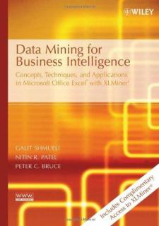
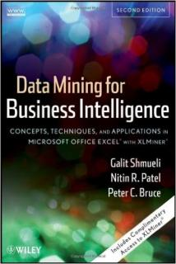
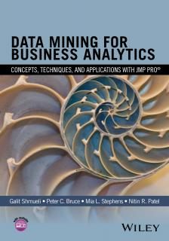

Textbook
OR
You may create a free account to download data and try out the examples given in the book
Publisher’s website: www.dataminingbook.com

Slide 15










